Slide 1

Group-2 MyCalendar- Training Mgmt. System
Presented by. :
46289282 Shrishti Singh
46290767 Devansh
46289312 Sejal Shrivastava
46283140 Preeti Jha
46292699 Ankit Kumar
46283097 Preetilisa Ray
Guided by. :
Shailaja Patil

Slide 2
TABLE OF CONTENTS
Objectives
Software Requirements
Features Implemented
Flow chart
Advantages
Conclusion

Slide 3
OBJECTIVE
The main objective of MyCalendar is to provide a platform which is only access by employee.
By using this platform an employee can do many functionality like schedule meeting , display calendar , display meeting , cancel meeting and many more.
The organizer and participants both acts like one entity as an employee in the meeting so that it is accessible by both.
This platform have user-friendly functionality which helps the employee to meets their goals and needs.

Slide 4
SOFTWARE REQUIREMENTS
Operating system: Linux
Software : Ubuntu
Back-end: C programming

Slide 5
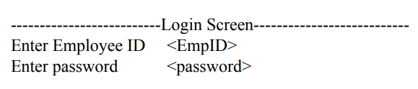
FEATURES IMPLEMENTED
The display Screen when MyCalendar starts-
The employees information is available in “employee.txt” file.
“employee.txt” file contains the following information like:
1.Employee ID
2.Employee password
3.Employee Name
3.Department
4.Mobile Number
5.Email
6.Skype ID

Slide 6
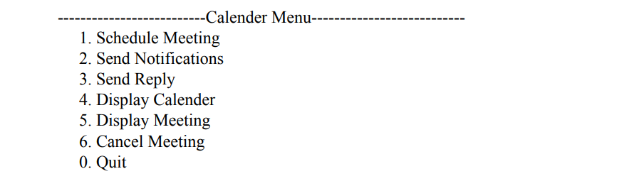
After entering the employee ID and Password it checked against entry in “employees.txt”. If it found the match “calender Menu” is displayed and otherwise “Invalid Employee ID and password”.
Schedule Meeting
“meeting.txt” file stores the information about the scheduled meeting.
“meeting.txt” file contains the following information like:
1. Meeting ID
2. Organizer Employee ID
3. Meeting Description
4. Meeting Duration
5. Meeting Status
6. Meeting Location
7. Number of participants

Slide 7
The meeting participants information is stored in “participants.txt” file.
“participants.txt” file contains the following information like:
1.Meeting ID
2.Employee ID
3.Notification Sent
4.Response received
5.Response Type
All these above information regarding meeting will asked and stored in corresponding more files.
After scheduling the meeting the organizer can send the notification.
The Organized meeting by the employee for which notifications are not sent will be displayed from “meeting.txt”.
“notification.txt” file contains the following information like:
1.Meeting ID
2.Notification ID
3.Sender Employee ID
4.Receiver Employee ID
5.Notification Text
Send Notification

Slide 8
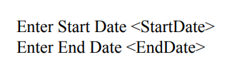
Send Reply
In the “participants.txt” field “Notification sent” will be marked as “Y”.
Notifications where “Receiver Employee ID” = “login Employee ID” and “Response received” = ‘N’ will be displayed from “participants.txt” and “notifications.txt”. User will select “Notification ID” to send reply.
We have to enter reply for to (Attend/Reject/Maybe).
Notification for which reply is sent will be deleted from “notifications.txt” file.
Display Meeting and Display Calendar
The meeting schedule will be displayed in ascending order of meeting date like <StartDate> to <EndDate>
Cancel Meeting
Meeting organizer only by login employee will be displayed.
All notifications corresponding to meeting Id will be deleted.
If we select ‘Y’ all entries will be deleted from “meeting.txt” and “participants.txt” files.

Slide 9
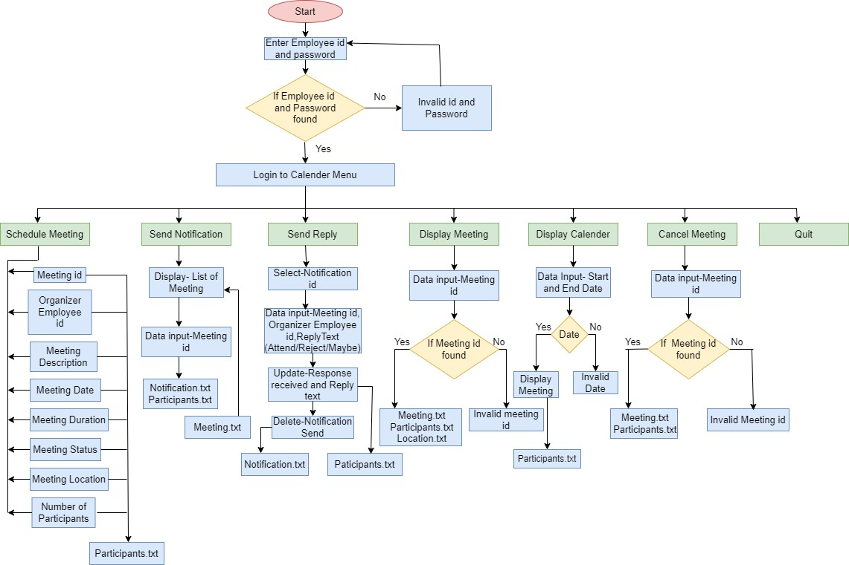
FLOW CHART

Slide 10
ADVANTAGES
Serve as a meeting organizer
Set notification
Saves time and Money
Enhanced security
Easy to organize and cancel meeting effectively

Slide 11
CONCLUSION
The entire project has been developed and deployed as per the requirements stated by the employee , it is found to be bug free as per the testing standards that are implemented which are planned to be developed in near future.
Finally , we like to conclude that we put all our efforts throughout the development of our project and tired to fulfill most of the requirements of the employee.

Slide 12
THANK YOU

